Slide 1
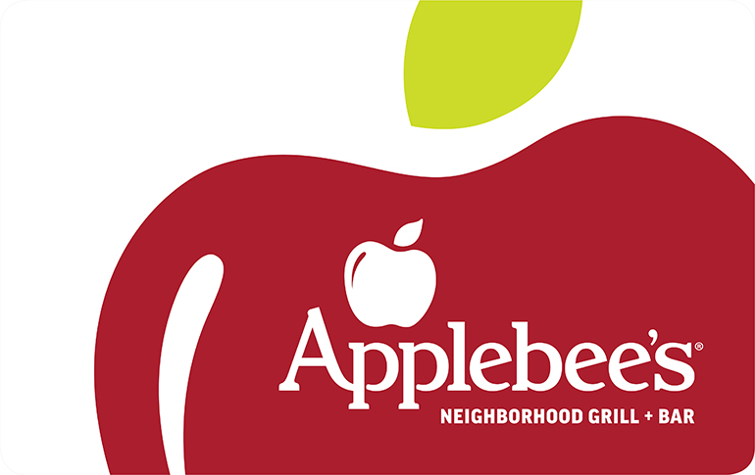
Final Project
MIS 670
Jessica Davis, Xin Fang

Slide 2
Business Problem & Approach
What is the average sentiment of on and off-topic tweets about Applebee's? What on/off topic keywords occur in negative and positive tweets?
Additional Issues Explored
Topics of tweets during unusually high and low sentiment
Development of a on and off-topic classification model
Network Analysis of Applebee's Twitter Network

Slide 3
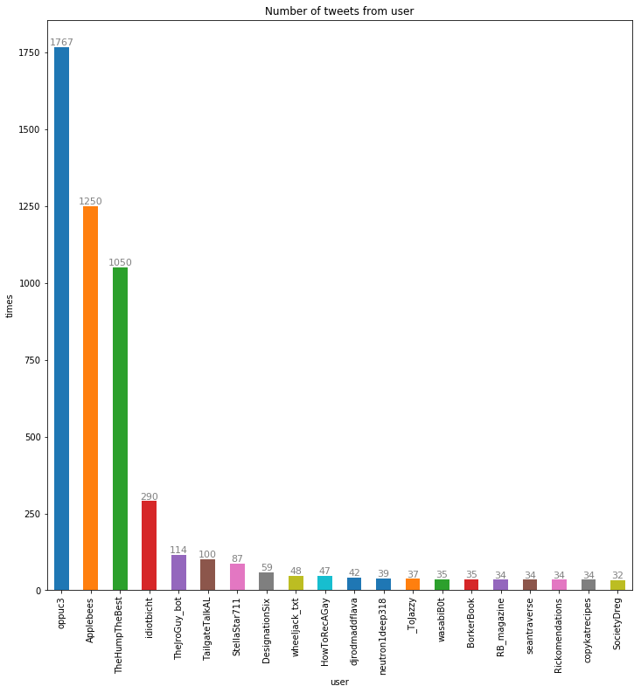
Number of Tweets from user

Slide 4
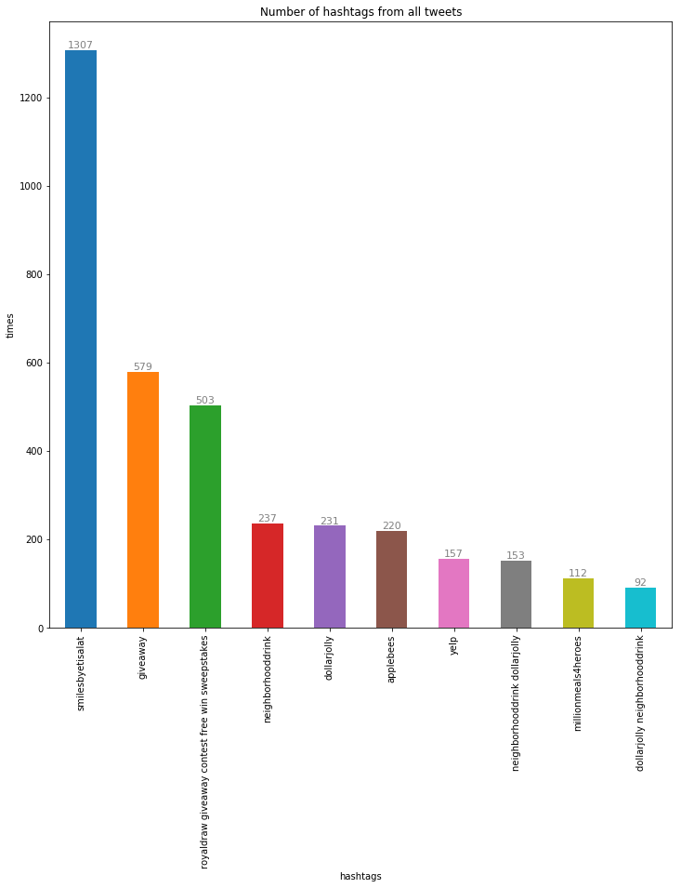
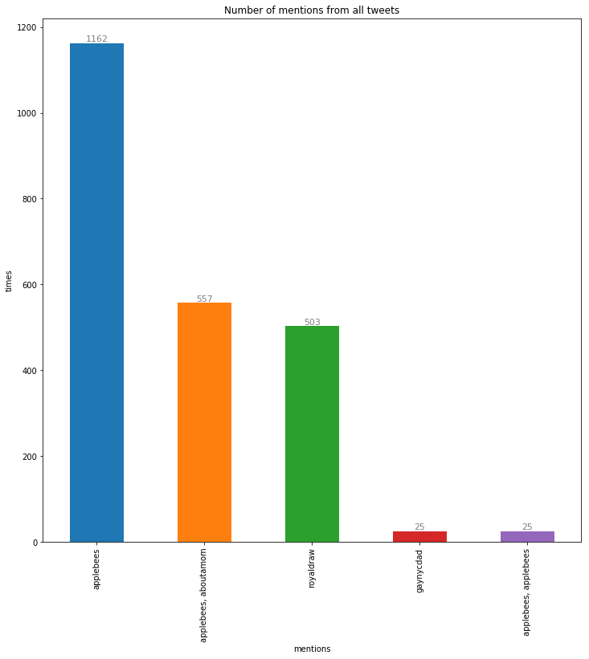
Number of hashtags/mentions from all tweets
Popular hashtags are mostly about giftcards, giveaways, and promotional items such as the dollar jolly drink and neighborhood drink promotions in general
References to promotions run on blogs aboutamom and gaynycdad
Mention boycott of fox news sponsors
Notes:
Popular hashtags are mostly about giftcards, giveaways, and promotional items such as the dollar jolly drink and neighborhood drink promotions in general
Popular mentions include references to promotions run on blogs aboutamom and gaynycdad
Consumers also mentioned a boycott of fox news sponsors that included Applebee's

Slide 5
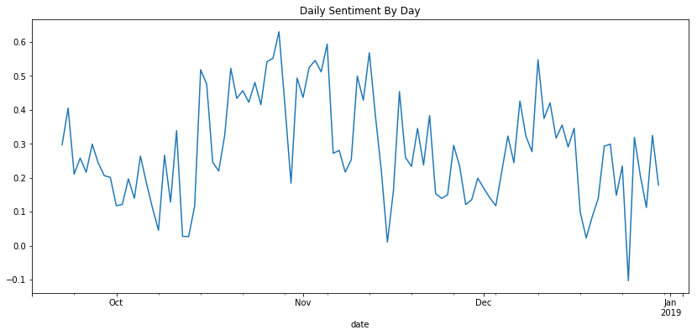
Daily Sentiment
Notes:
* 10/26 and 11/05 had the highest daily sentiment scores of the period.
* 12/25 and 11/15 had the lowest sentiment of the period.

Slide 6
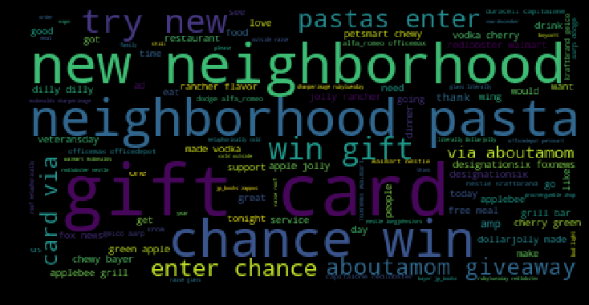
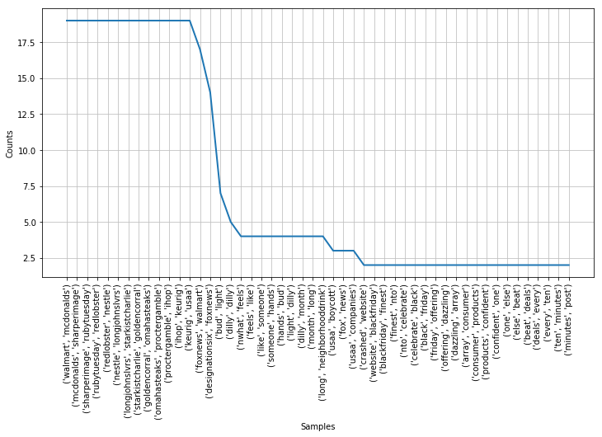

On Topic Word Frequency
Notes:
### Even when tweets were filtered by on-topic keywords foxnews tweets remained. There were also a lot of tweets about budweiser's dilly dilly campagin which also doesn't seem to be on-topic on the surface. There are a lot of mentions abotu consumer products, deails, and black friday as well.

Slide 7
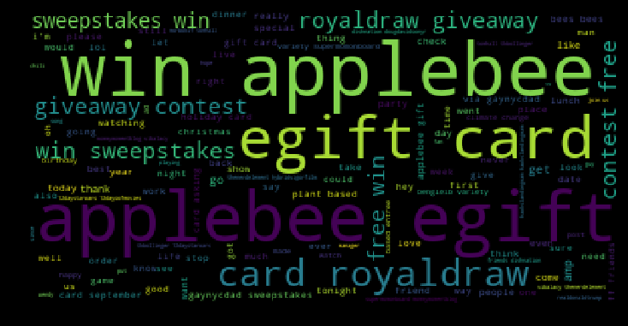
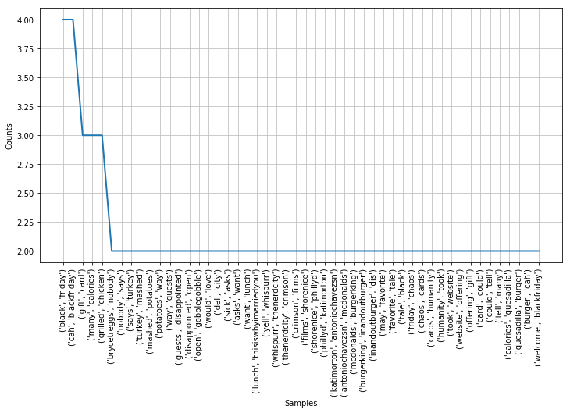
Off-Topic Word Frequency
Notes:
Popular bigrams in off-topic tweets do not include fox-news boycott terms. Instead they include terms about black-friday, and many other topics that are difficult to categorize or tie to applebee's
On-topic tweets have a higher average than off-topic tweets (.35 vs .30) both categories can be classified as positive.

Slide 8
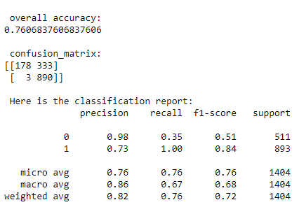
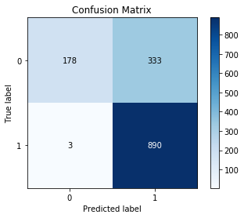
Text Classification
Did not misclassify many off topic tweets as on topic
Classified many on topic tweets as off-topic (333).
May be because of the non-specific keywords that were used to create the on and off-topic datasets.
Notes:
The model did not misclassify many off topic tweets as on topic, but classified many on topic tweets as off-topic (333). This may be because of the non-specific keywords that were used to create the on and off-topic datasets. If more specific keywords were used to separate on and off topic tweets, the model may be better at classifying the tweets

Slide 9
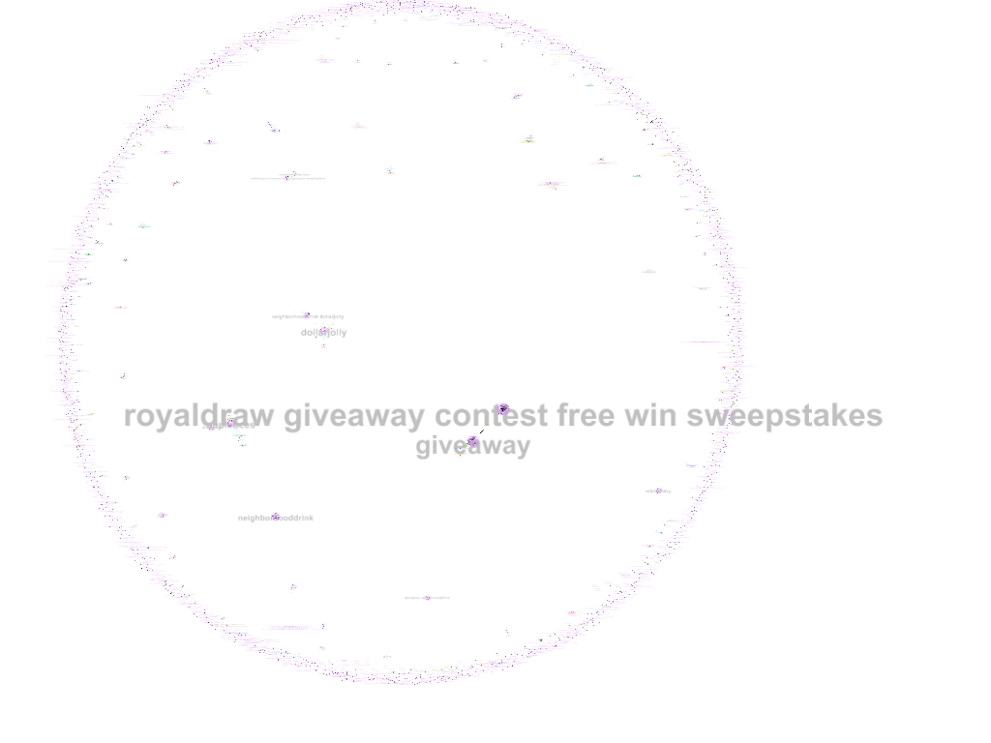
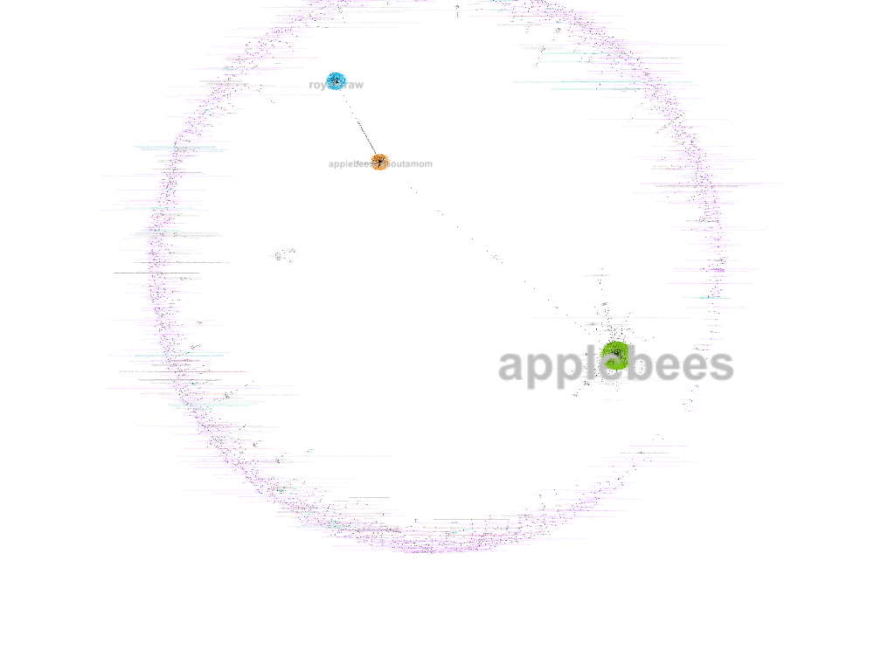
Network Analysis
Hashtags
Mentions

Slide 10
Recommendations
Applebee's should continue to partner with blogs to sponsor giveaways and promotions
Applebee's should increase the number of hashtags it uses on its account that mentions #Applbees and its promotional items
Applebee's can use topic modeling to determine what promotional and ad campaigns are successfully contributing to peaks in sentiment in the future
Applebee's can also use topic modeling to determine if periods of low sentiment are due to off-topic issues, or due to customer service related issues.

